Slide 1

Presentation: BI Analysis

Slide 2

Matthew
NEWSON
Sakshi
Megha
Clément ARNAUD-
SARTHOU
Abishek
KUMARI
SIVASANKAR
THAMIZHARASAN

Slide 3

Our company name is ISEP Business Consulting & We propose
Dashboards to help the doctors visualize the data and find possible links
with the no show appointments. We are specialized in addressing the
issue of no-show appointments, our goal is to overcome the challenges
associated with missed appointments.
our values
Trust
Reliability
We are committed
to providing a
reliable and
consistent
appointment
experience for
both clients and
service providers.
Satisfaction
Integrity
Our goal is to
ensure the
We approach the
issue of no-show
appointments with
utmost integrity,
striving for
transparency and
accountability in
our solutions.
Building trust with
our clients is
satisfaction of both
clients and service
providers by
reducing the
occurrence of no-
show
crucial in
addressing the
issue of no-show
appointments.
appointments.

Slide 4

Use Case Presentation
Data Cleaning
Data Modeling
Data Analysis
Review of Our Work

Slide 5


Slide 6

Engaged by appointment-based businesses, our mission is
as follows:
Optimize appointment attendance rates
Provide clear directions for improving appointment
management
Optimize resource allocation By leveraging our expertise,
we aim to enhance the competitiveness of appointment-
based businesses.

Slide 7

Appointment Type
Healthcare Provider
Patients
Appointment Details
Notification System
Tracking and Reporting

Slide 8

In the doctor-patient scenario, we have access to four datasets containing
information related to appointments. Our objective is to analyze this data and
generate a detailed report that can be utilized by various stakeholders within
the organization. The report aims to improve efficiency for some individuals
and enable better prediction capabilities for others.
Areas of Study:
Appointment Analysis
Appointment Prediction
Impact of Appointment Reminders
Patient Segmentation
Cost Analysis

Slide 9
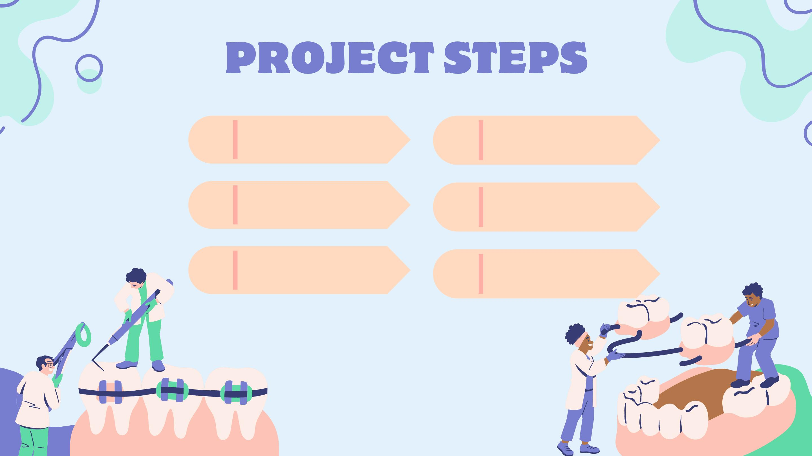
Data Collection
Add extra tables
Our Dashboard
Data Cleaning and
Preparation
Data Modeling
Data Vizualisation

Slide 10
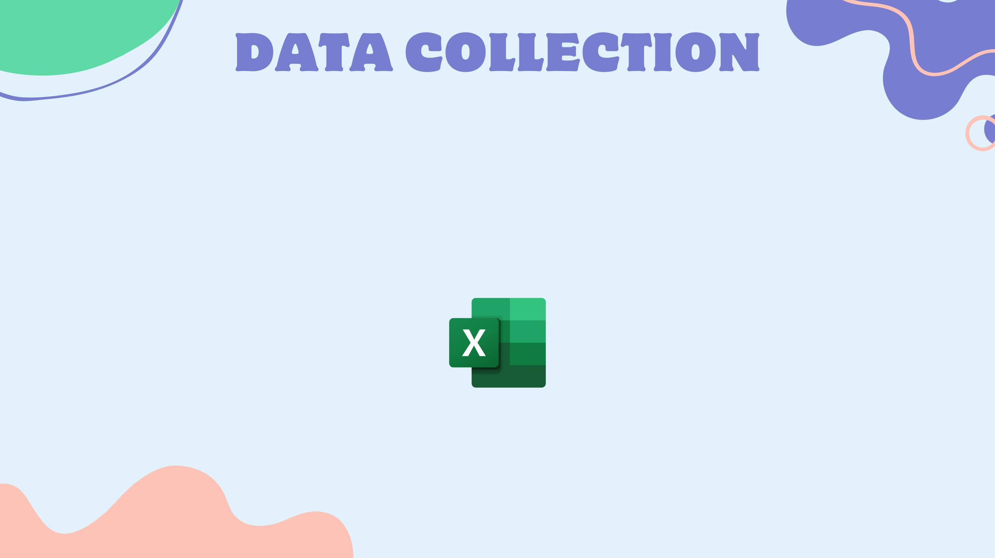
WE COLLECT THE DATA FROM A CSV FILE NAMED
'NOSHOWAPPOINTMENTS2016'
NoShowAppointments2016

Slide 11


Slide 12

PatientId: It is the unique ID given to each patient.
AppointmentId: It is the unique ID given to each appointment between the doctor and the patient.
Gender: It gives us the gender of the patient where M means Male and F means Female.
ScheduleDay: It shows us the date and time when the appointment is scheduled.
AppointmentDay: It shows us the date and time of appointment. But the problem is there are many
appointments with the same date and time.
Age: It gives the age of the patients.
Neighbourhood: It tells about neighbourhood, the place where the patient stays.
Scholarship: If the patient holds any scholarship or not. 0 means not a holder and 1 means they hold
the scholarship.
Hypertension: If the patient has hypertension or not. 0 means no and 1 means yes.
Diabetes: Indicates if the patient is diabetic or not. 0 means no and 1 means yes.
Alcoholism: Indicates if the patient is an alcoholic or not. 0 means no and 1 means yes.
Handicaped: Indicates if the patient is handicaped or not. 0 means no and 1 means yes. But we have
other unknown values as well such as 2, 3 and 4 which does not make sense.
Sms_received: Indicates if the patient has received a reminder sms or not. 0 means no and 1 means
yes.
NoShow: Indicates if the patient is showed up for the appointment or not. 0 means showed up and 1
means did not show up.

Slide 13


Slide 14
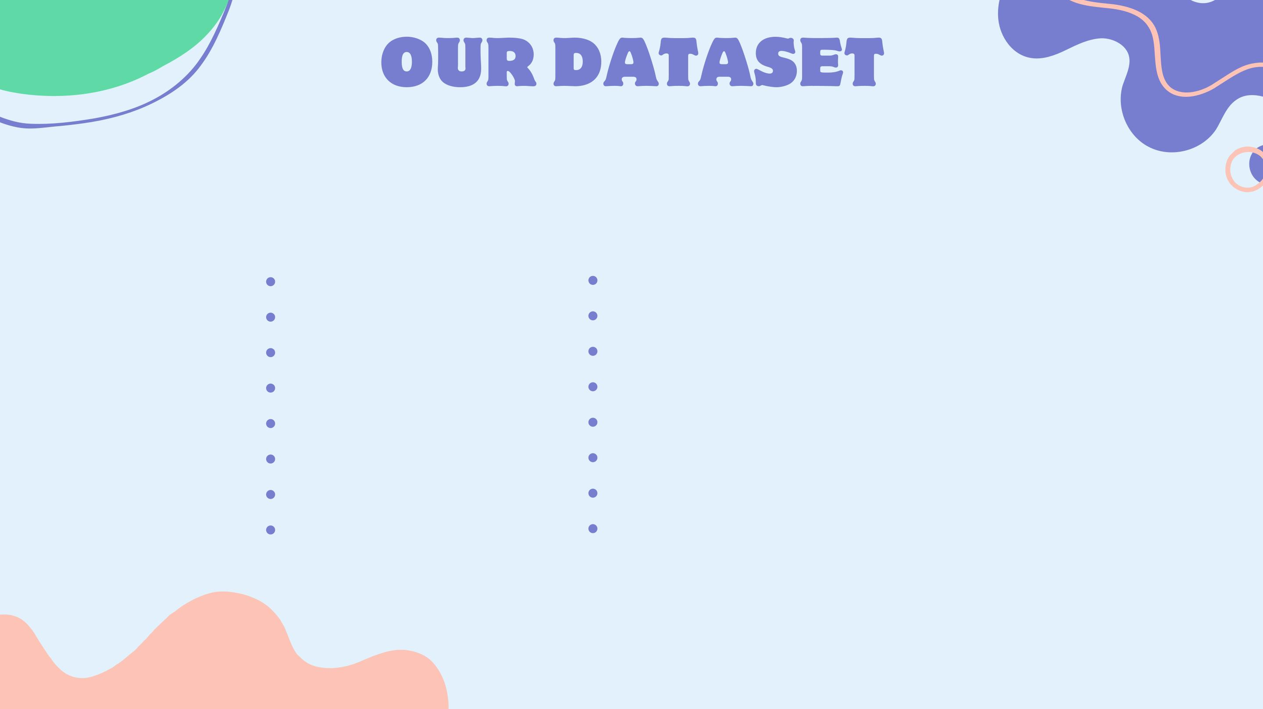
This dataset is composed of one table containing 16 columns
NO SHOW APPOITMENT TABLE :
PatientID
Hypertension
AppoitmentID
Gender
Alcoholism
handcap
ScheduledDay
AppoitmentDay
Age
SMS_Recevied
No show
Age category
weekday Appoitment day
Weekday
Neighbourhood
Scholarship

Slide 15
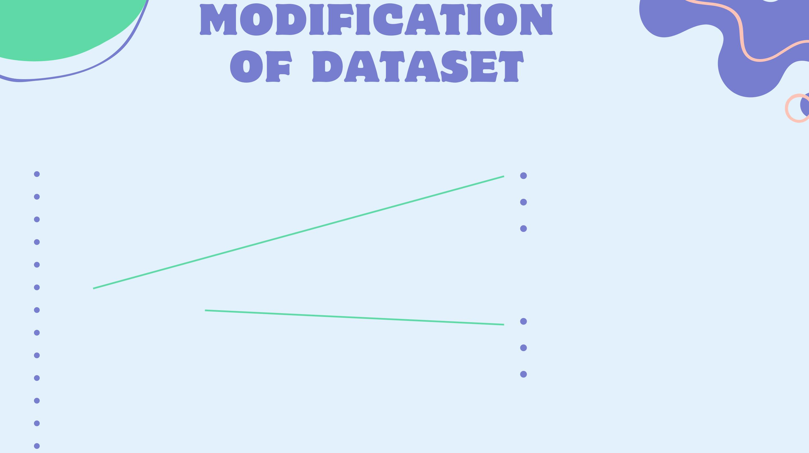
We add two extra tables to have additional features and limitate the storage of data
NO SHOW APPOITMENT
AGE
PatientID
Age
AppoitmentID
Gender
Age category
Minor adult
ScheduledDay
AppoitmentDay
Age
NEIGHBOURHOOD
Neighbourhood
handcap
Neighbourhood
Neighbourhood V4
Neighbourhood V6
SMS_Recevied
No show
Age category
weekday Appoitment day
Weekday

Slide 16
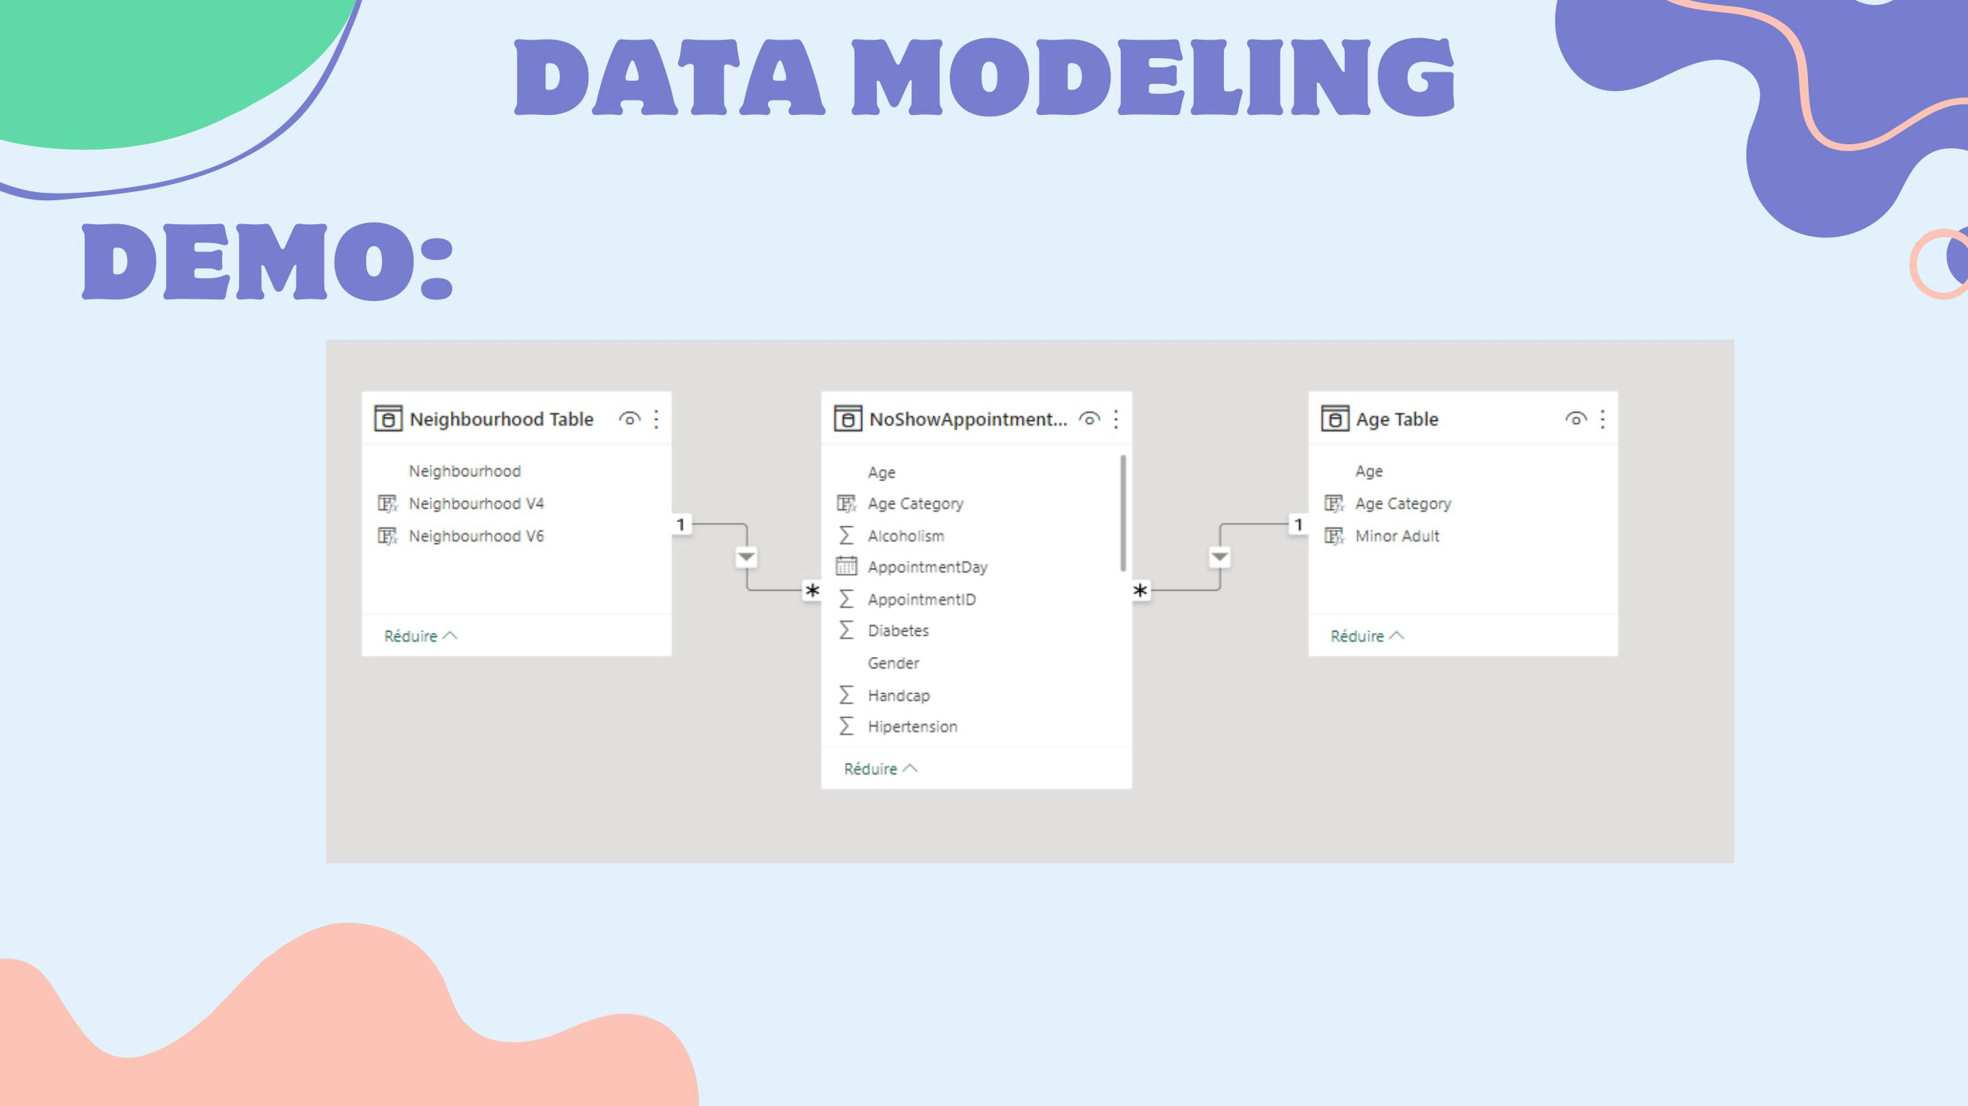

Slide 17

We divided our dashboard into 4 pages to facilitate the
navigation and the comprehension of its elements. The 4 pages
are : Home, No-Shows, Shows, Patients
OUR MAIN DATA KPIs
No-Show Rate ; Patient Map ; Appointment by weekday ;
Appointment by Age category ; Number of patients ;
Appointment by gender

Slide 18
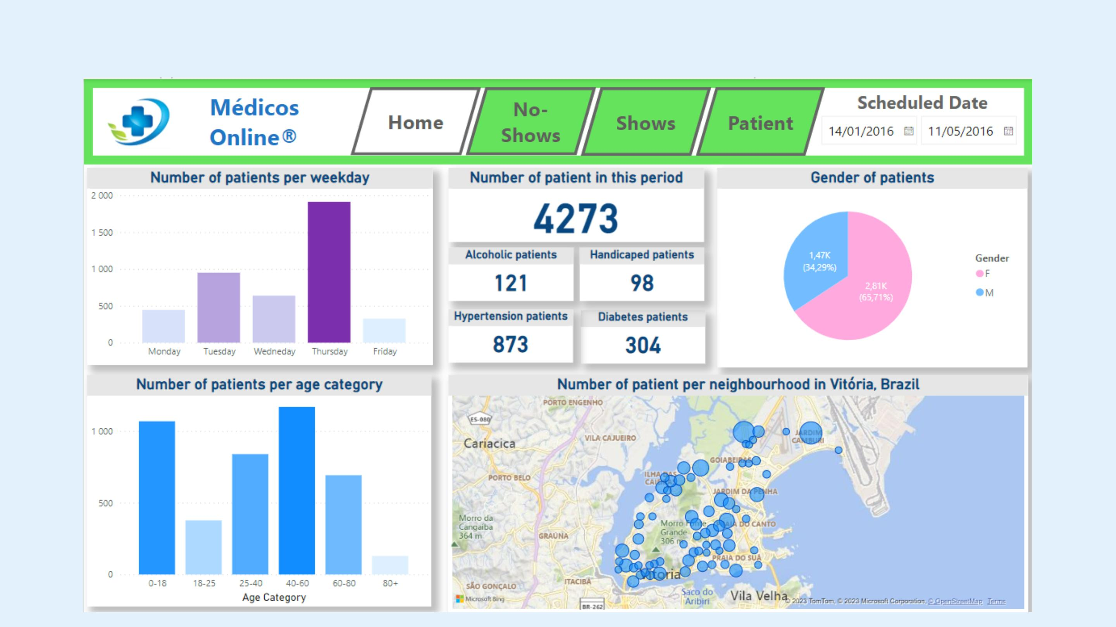
1st page : Home

Slide 19
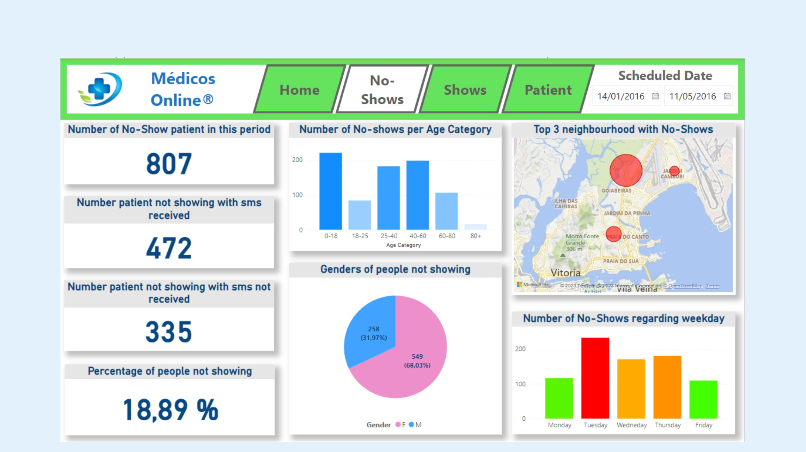
2nd page: No-Shows

Slide 20
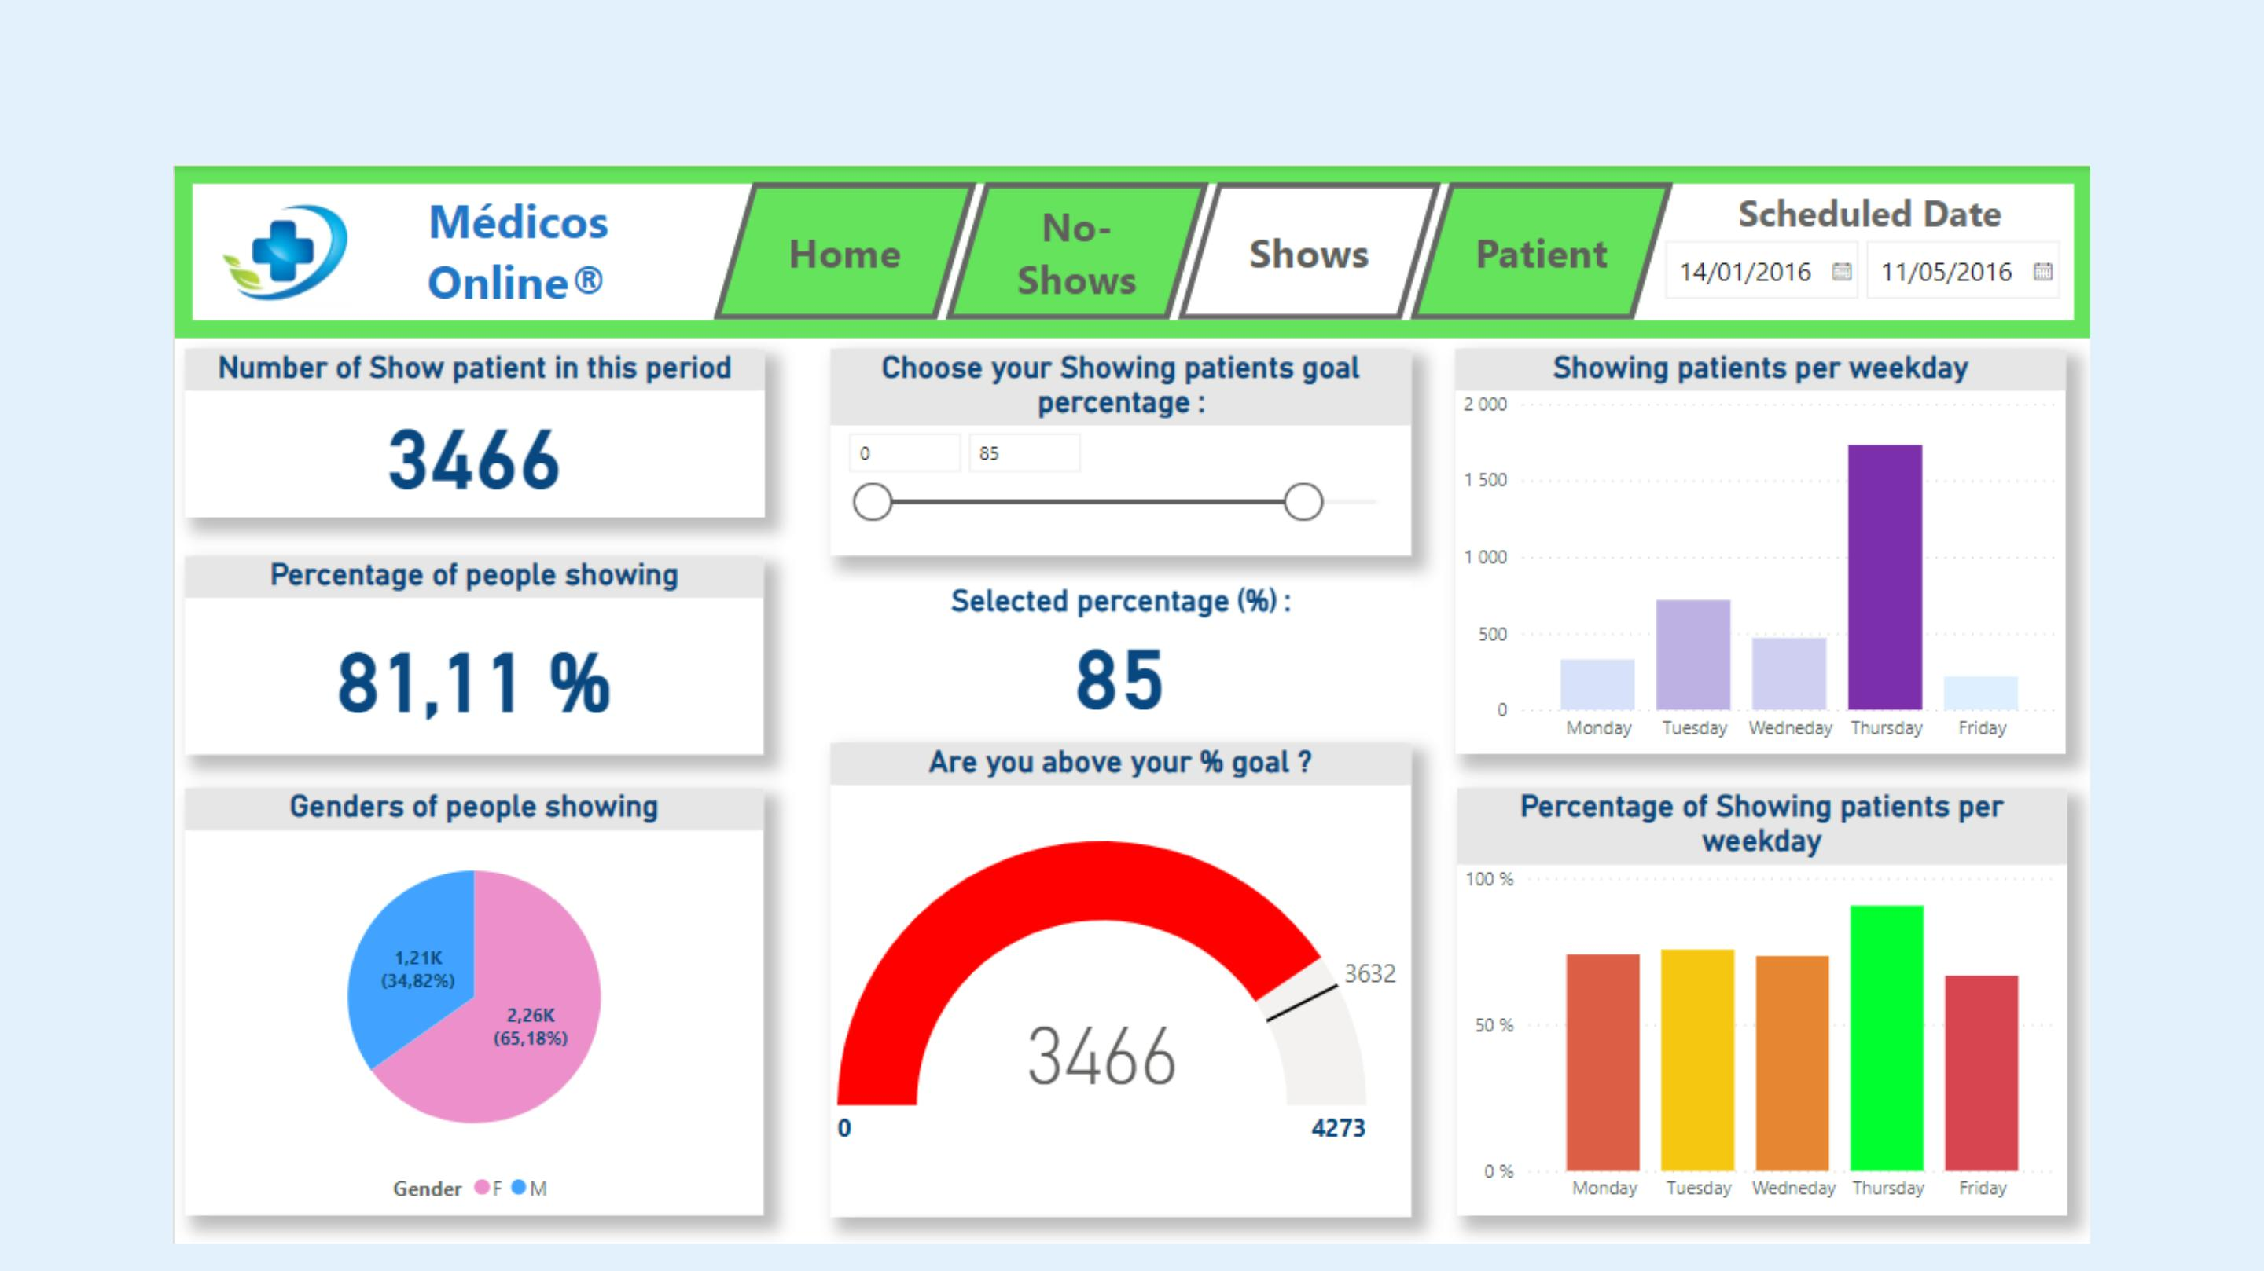
3rd page : Shows

Slide 21
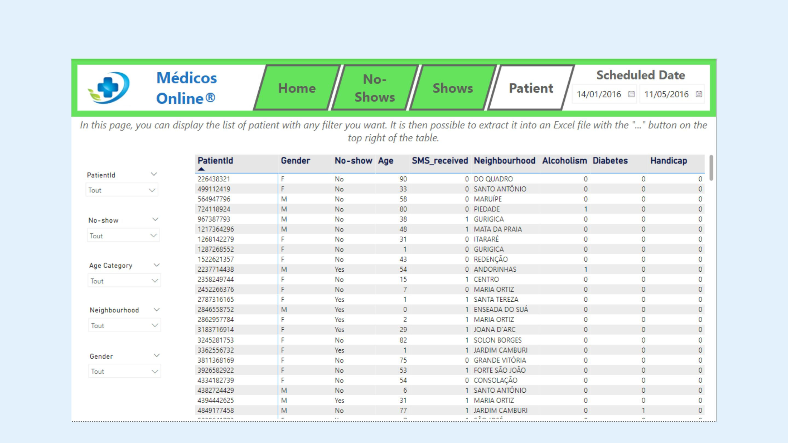
4th page : Patients

Slide 22
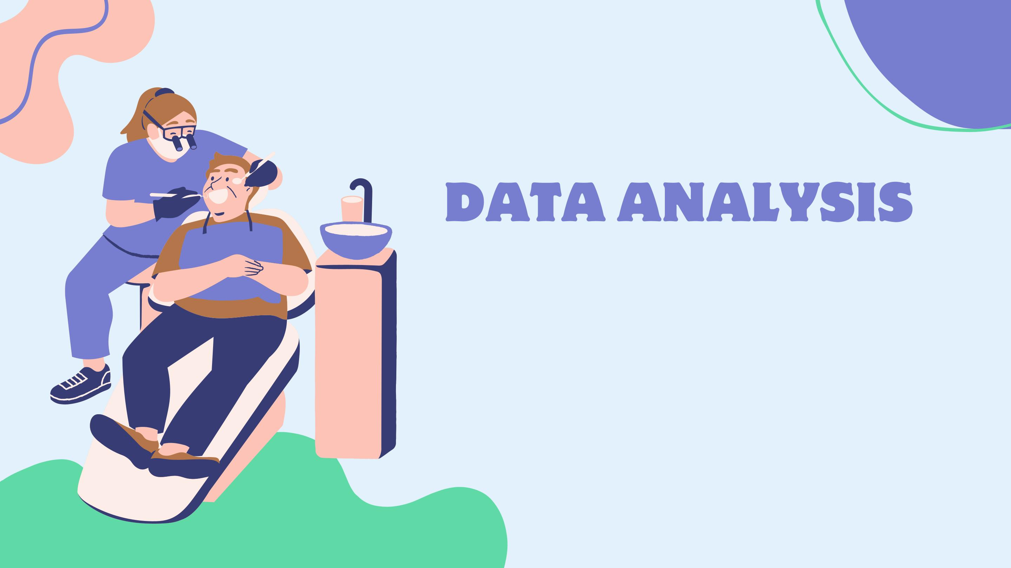

Slide 23
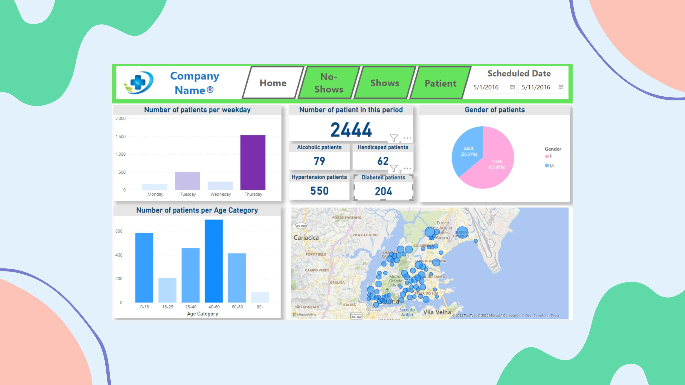
ANALYSIS OF OUR DATA

Slide 24

1. Identification of patients at risk of no-shows: Through data analysis, we can identify
patterns and factors that contribute to appointment no-shows. This includes demographic
information, previous appointment history, and other relevant variables.
2. Implementation of appointment reminders: By leveraging the data, we can develop and
implement automated appointment reminders through various channels such as SMS,
email, or mobile applications. This proactive approach helps reduce no-show rates by
keeping patients informed and reminding them of their scheduled appointments.
3. Optimal scheduling and resource allocation: Analyzing appointment data allows us to
identify peak no-show periods and adjust scheduling accordingly. By optimizing
appointment slots and allocating resources effectively, we can minimize the impact of no-
shows on the doctor's schedule and ensure efficient use of healthcare resources.
4. Patient engagement and education: Data analysis can uncover insights into patient
behavior and preferences. This information can be used to develop targeted engagement
strategies, such as educational materials, personalized communication, and incentives, to
increase patient commitment and reduce the likelihood of no-shows.
In summary, our data analysis enables the identification of at-risk patients, the
implementation of appointment reminders, optimal scheduling and resource allocation, and
patient engagement strategies to reduce no-show rates in the context of doctor-patient
appointments.

Slide 25

LIMITATION OF OUR ANALYSIS
1. Limited patient information: Due to the absence of comprehensive patient profiles,
including demographic, medical history, and socioeconomic factors, the analysis
may lack a detailed understanding of the underlying reasons for no-show
appointments.
2. Data accuracy and completeness: The reliability of the findings heavily relies on
accurate and complete appointment data. Inaccurate or missing data entries could
potentially impact the accuracy of predictions and hinder the identification of
meaningful patterns or trends.
3. External factors: The analysis does not account for external factors that can influence
appointment attendance, such as transportation issues, personal emergencies, or
competing priorities. These factors can significantly affect the reliability of
predictions or recommendations derived from the analysis.
4. Lack of qualitative insights: The analysis primarily focuses on quantitative data and
may overlook qualitative insights from patients or healthcare providers. Gathering
patient feedback or understanding their perspectives on appointment processes
could provide valuable context for addressing the no-show issue more effectively.

Slide 26


Slide 27

CHALLENGES ENCOUNTERED
Neighbourhood column is not accurate enough
Obtaining accurate and complete patient data for
analysis.
Dealing with missing or incomplete appointment
records.
Addressing privacy and data security concerns when
handling patient information.
Ensuring data consistency and quality across different
sources.
Overcoming scheduling conflicts and coordinating
appointments effectively.
Managing and mitigating the impact of unexpected
events or emergencies on appointment attendance.

Slide 28

Thank you for watching this
presentation! Would you happen to
have any questions or suggestions?

